Slide 1

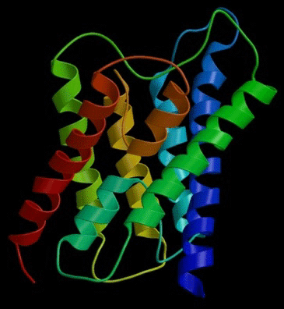
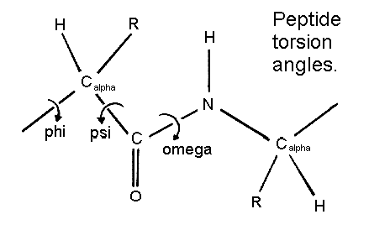
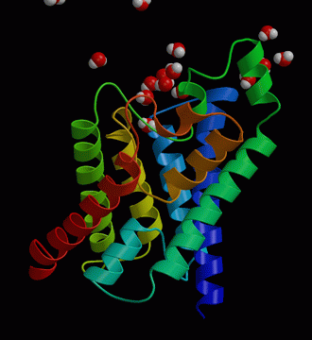
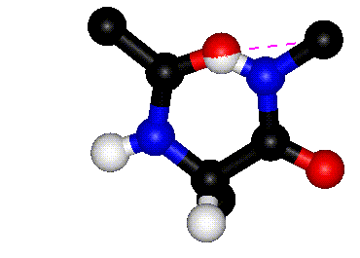
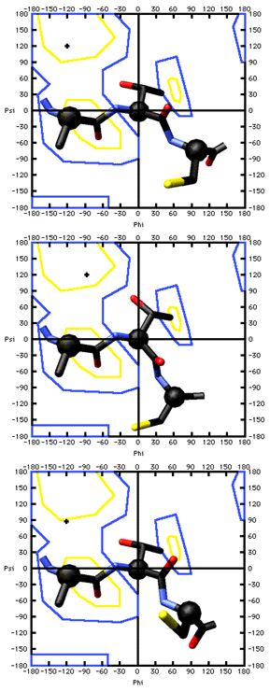
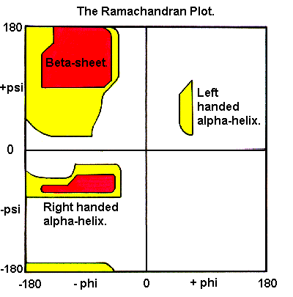
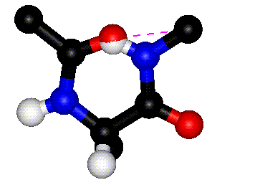
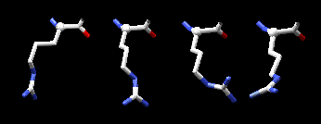
Understanding
Contortions in Protein Structures
Conformations and Torsions
Dr. A Mitra
IIIT Hyderabad

Slide 2
PEPTIDE TORSION ANGLES
Relatively free to rotate
Rotation difficult

Slide 3
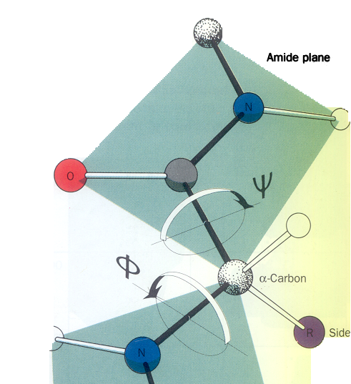
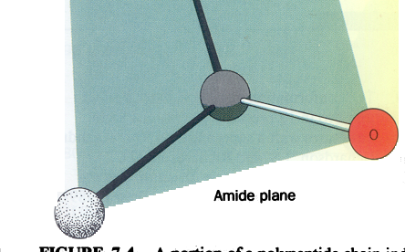
PEPTIDE TORSION ANGLES
= ψ = 180º

Slide 4
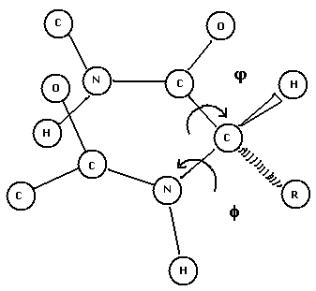
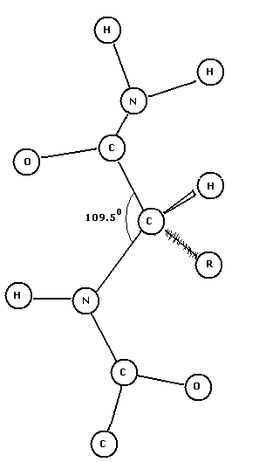
PEPTIDE TORSION ANGLES

Slide 6
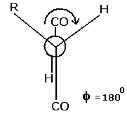
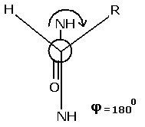
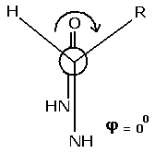
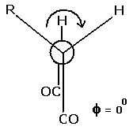
PEPTIDE TORSION ANGLES
GETTING CONFUSED?
Let’s get them one by one
First Phi then Psi

Slide 7
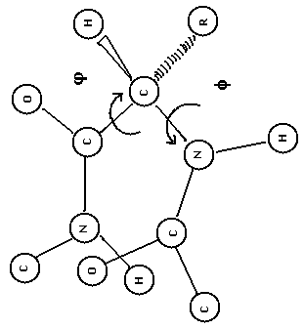
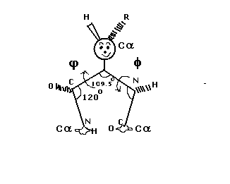
PEPTIDE TORSION ANGLES
A DIFFERENT KIND OF MODELING

Slide 8
1 Antiparallel β-pleated sheet
1
2
3
2 Left Handed II Helix
(Polyglycine and Poly-L-proline)
4
5
6
3 Collagen
4 Parallel β-pleated Sheet
7
5 2.2₇ Ribbon
8
9
6 Left Handed α-Helix
7 Right Handed 3₁₀ Helix
8 Right Handed α-Helix
9 Right Handed π-Helix

Slide 9
LET US GO BEYOND CLASHES

Slide 10
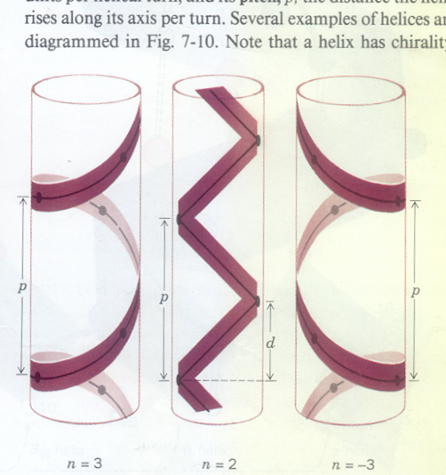
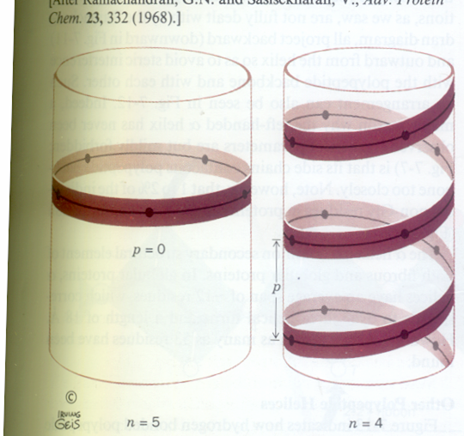
ANALYSING HELICES
n = number of residues per turn
p = rise in angstroms per turn
d = p/n = rise in angstroms per residue

Slide 11

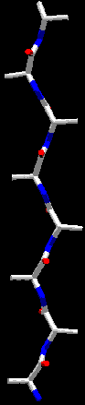
Intramolecular
Hydrogen Bonding:
Different Types
of
Helices
2.2₇ Strand
3₁₀ Helix
3/6.0/2
-49/-26
H
3.6₁₃ Helix (α-Helix)
3.6/5.4/1.5
-57/-47
H
4.4₁₆ Helix (π-Helix)
16
4.4/5.2/1.18
-57/-70
15
H
16
φ/ψ
n/p/d
14
13
13
12
H
10
11
10
9
H
8
7
6
H
7
5
4
3
2
1

Slide 12
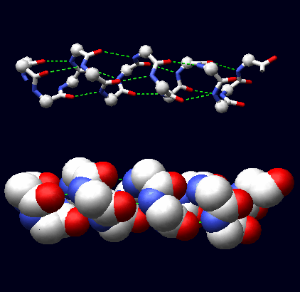
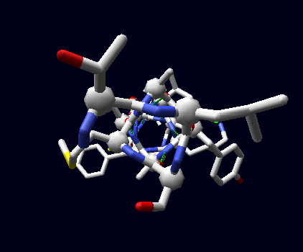

Slide 13
1 Antiparallel β-pleated sheet
1
2
3
2 Left Handed II Helix
(Polyglycine and Poly-L-proline)
4
5
6
3 Collagen
4 Parallel β-pleated Sheet
7
5 2.2₇ Ribbon
8
9
6 Left Handed α-Helix
7 Right Handed 3₁₀ Helix
8 Right Handed α-Helix
9 Right Handed π-Helix

Slide 14
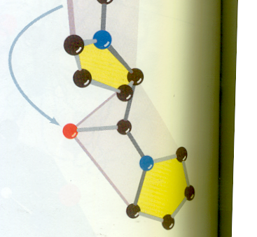
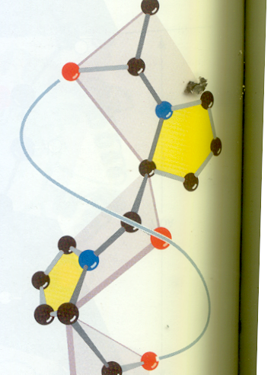
POLY PROLINE
A
LEFT
HANDED
HELIX

Slide 15
1 Antiparallel β-pleated sheet
1
2
3
2 Left Handed II Helix
(Polyglycine and Poly-L-proline)
4
5
6
3 Collagen
4 Parallel β-pleated Sheet
7
5 2.2₇ Ribbon
8
9
6 Left Handed α-Helix
7 Right Handed 3₁₀ Helix
8 Right Handed α-Helix
9 Right Handed π-Helix

Slide 16
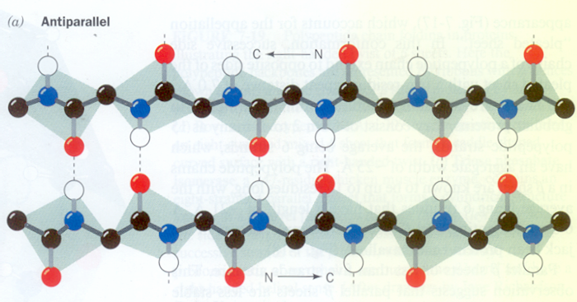
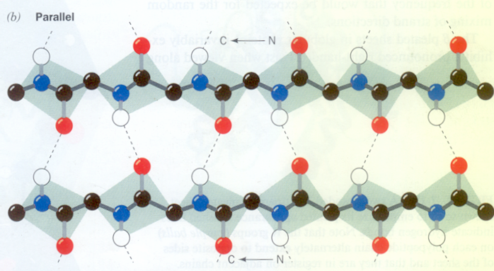
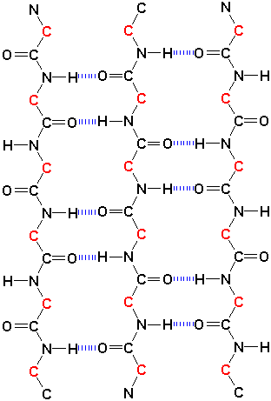
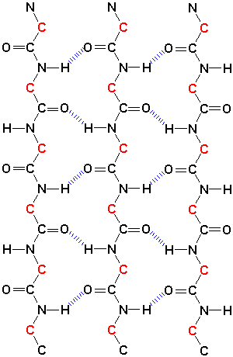

Slide 18
φ = -139
ψ = 135
1 Antiparallel β-pleated sheet
1
2
3
2 Left Handed II Helix
(Polyglycine and Poly-L-proline)
4
5
6
3 Collagen
4 Parallel β-pleated Sheet
7
φ = -119
ψ = 113
5 2.2₇ Ribbon
8
9
6 Left Handed α-Helix
7 Right Handed 3₁₀ Helix
8 Right Handed α-Helix
9 Right Handed π-Helix

Slide 19
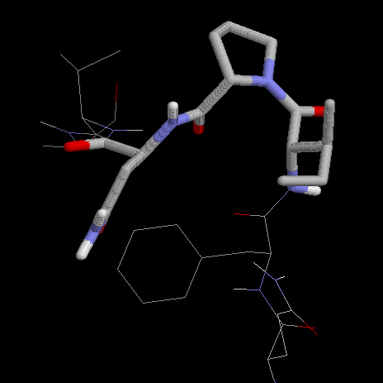
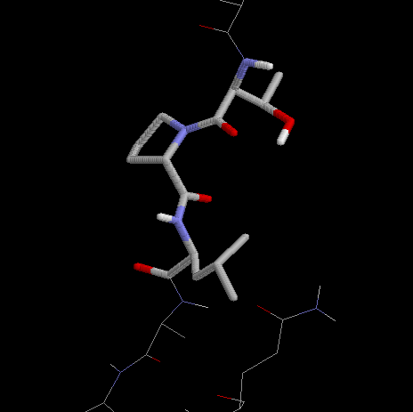
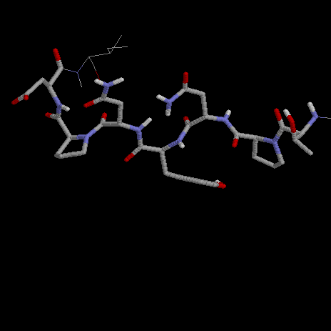
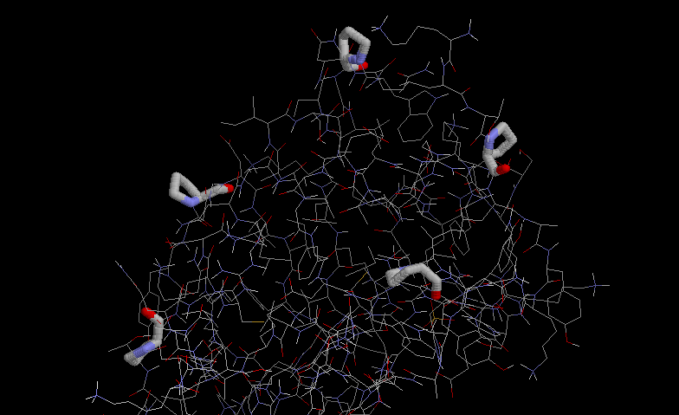
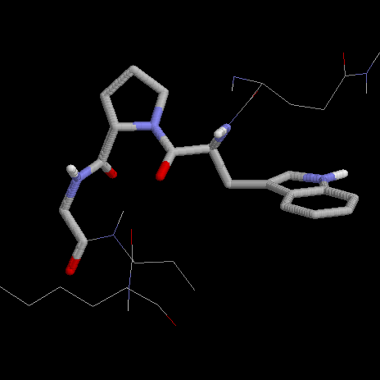
spdbv
rasmol
and now omega

Slide 20
Focussing on Turns
main

Slide 21
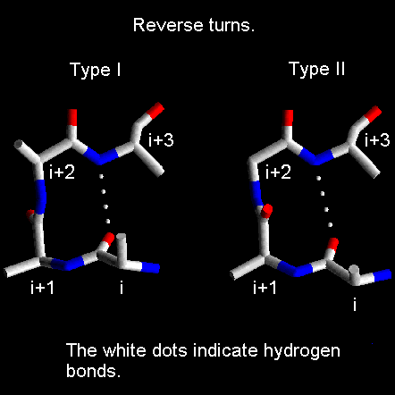
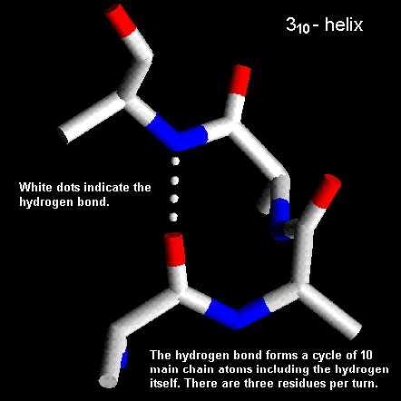
COMPARING A 310-HELIX WITH REVERSE TURNS

Slide 22
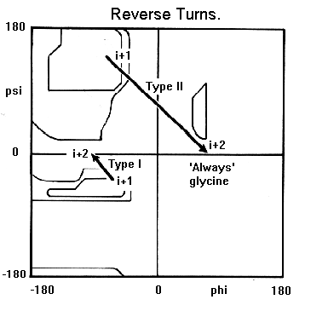
Types of Turns
Type I

Slide 23
A Look at the Side Chains

Slide 24
Some conformations that can be adopted by Arginine

Slide 25
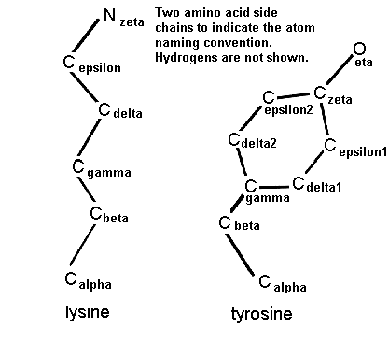

Slide 26
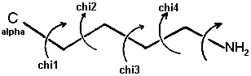
The side chain torsion angles are
named χ₁(chi1), χ₂(chi2), χ₃ (chi3), etc.,
as shown below for lysine

Slide 27
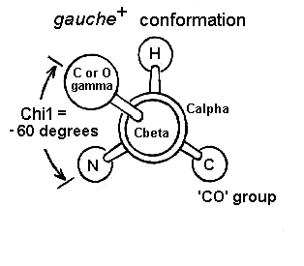
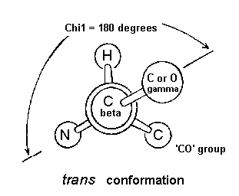
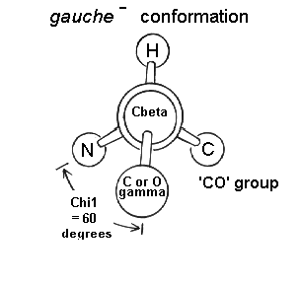
The χ₁ angle is subject to
steric hindrance between the γ side chain atom(s) and the main chain

Slide 28
Learn More About Ramachandran Plots

Slide 29
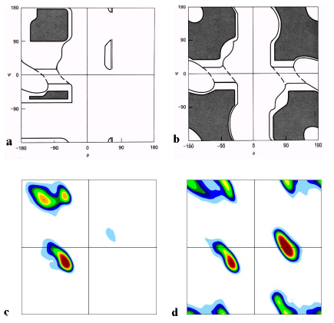
The classical version of the Ramachandran plot for a) alanine (but often taken as typical for all non-glycines) and b) glycine according to Ramachandran and Saisekharan, 1968. The fully allowed regions are shaded, the partially allowed regions are enclosed by a solid line. The connecting regions enclosed by the dashed lines are permissible with slight flexibility of bond angles. These plots were arrived at by computer modelling.
. Although some overall features of these plots are correct, the details differ from the experimentally observed Ramachandran plots for c) all 19 non-glycines and d) glycine.
The most remarkable differences are that
1. Most regions show a 45 degree slope rather than being parallel to any of the axes
2. The β-sheet region is split into two distinct maxima
3. The two most populated regions for glycine seen in d) were predicted to be only just permissible as shown in b).
4. The corner region of Gly is allowed, although it was predicted not to be.
Acta Cryst D58 (2002) 768-776

Slide 30
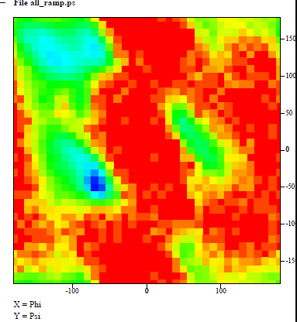
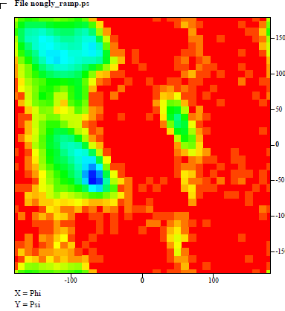

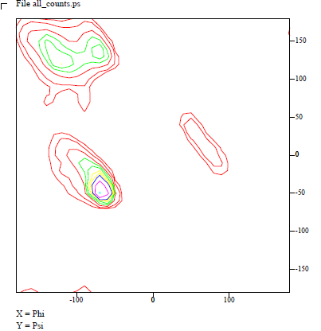
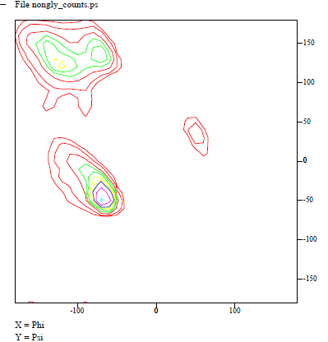
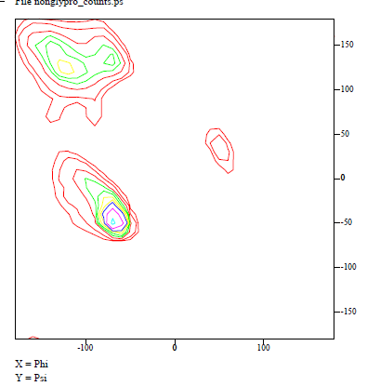

Slide 31
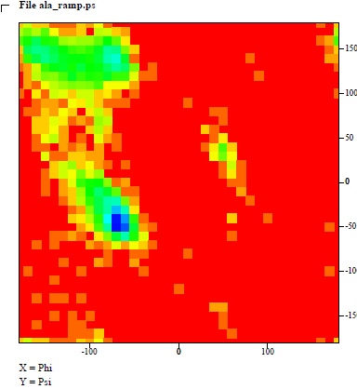
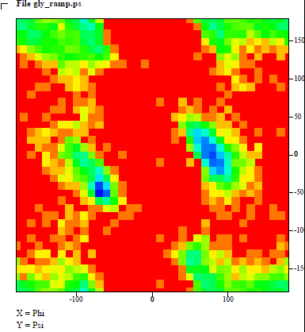





Slide 33



Slide 34
ASSIGNMENT
Take proteins of your choice and find
3 helices
3 parallel strands
3 anti parallel strands (at least 8 residues long)
Report φ, ψ, ω

